Slide 1

Backplane Termination
Transmission Line Principles
Characteristic Impedance Z₀
Signal Velocity and Propagation Delay
Signal Reflections and Termination
©Paul Davies. Not to be copied, used, or revised without explicit written permission from the copyright owner.
This lecture may contain animations and is best viewed as a slide show

Slide 2
Question:-
If I have a battery connected to a switch, and from there to an open circuit, what current flows when the switch closes?
Think about it for a few moments. The answer is of fundamental importance to this lecture on backplane (and signal) termination.
Does your answer change if an electrical load is placed at the end of the circuit?
Switch
Battery
Open Circuit
Switch
Battery
Z_{t} = terminating impedance of receiver

Slide 3
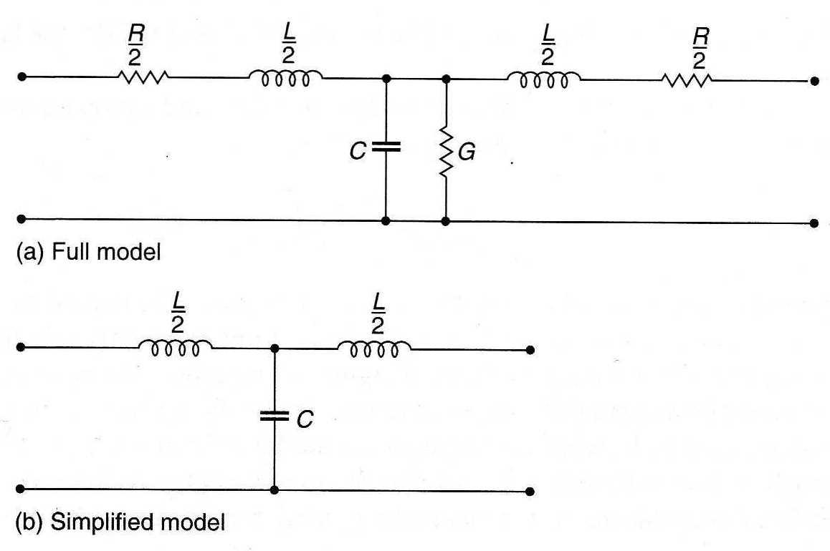
As clock and hence signal ‘edge’ (i.e. dV/dT) speeds increase, we can no longer consider a conductor as simply a piece of wire with purely resistance properties.
At higher dV/dT we have to consider the conductor as a “transmission line” which is in fact two conductors. The conductor carrying the signal is one of them. The other is any adjacent conductor or a path to ground, neither of which may obviously be connected electrically to the first.
The illustration below is the classical model of an infinitely small section of a conductor.
Real conductors, can be considered as an infinite number of these sections distributed over its length and exhibiting resistive, inductive and capacitive properties.
As dV/dT increases, the tiny C and L components have increased effect on the signal.
‘C’ is the Capacitance per meter of the conductor measured relative to an adjacent conductor and is affected by the conductor cross sectional area and the properties of the dielectric (insulator) that separate the conductor from the adjacent signal.
‘L’ is the Inductance per meter of the conductor and its value is affected by its geometry and material i.e. how the conductor is laid out - its dimensions, twists and curves etc.
Input
Output
‘R’ is the Resistance per meter of the conductor.
‘G’ is the conductance (1/resistance) per meter between adjacent conductors and gives rise to a tiny leakage current.
Adjacent Conductor/Ground

Slide 4
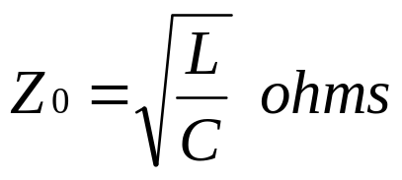
In modern digital circuits, if conductors and materials are well designed, the values of R and G can be ignored since R is small and the signal conductor is well insulated from its neighbour, leaving us with the simplified model below.
This leads us on to a discussion of the Characteristic Impedance of the Transmission Line and its effect on signal propagation.
The Characteristic Impedance Z₀ of a Transmission Line
The characteristic Impedance Z₀ of a transmission line is the impedance it offers to a signal when presented with a sudden change in input voltage, such as the step output voltage from a logic gate is it transitions between 0’s and 1’s. It is measured in ohms and is independent of length.
This is not the same as steady state resistance. That occurs when voltages and currents have stabilised and the resistance of the transmission line is close to 0.

Slide 5
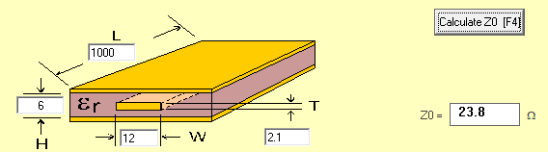
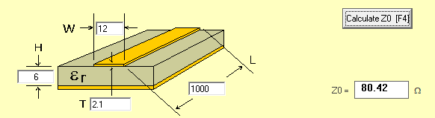
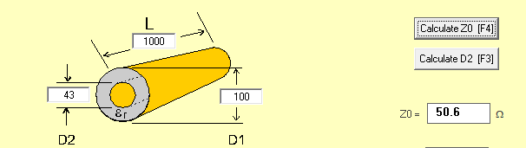
Z₀ calculated for different conductors using free “AppCad”
Strip Line PCB
Micro Strip PCB
Round Coax Cable

Slide 6
Characteristic Impedance for Other Conductors
Medium Z₀(ohms)
Free Space (Vacuum) 377
Single wire (Far from Ground) 600
Twisted Pair cable 80-120
Flat Cable 80-120
Surface Track on a PCB 70-100
Back Plane Bus Line 50-100

Slide 7
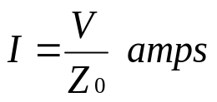
What is the relevance of this?
When a ‘step’ voltage is presented to a T.Line, a large dV/dt is initially applied, thus the current ‘I’ that flows is initially impeded by the back e.m.f. created by the inductance in that section of the line. The back e.m.f. ceases once the current reaches a steady state value i.e. when the signal stops changing and dV/dt = 0.
The effect of the back emf is to limit the current in much the same way as a resistor.
The resulting (lower) current is used to charge/discharge the small capacitance of that section of the conductor slowing the rise/fall time of the signal in that section. This effect propagates to the next LC section of the line, throughout its length.
I
Back EMF resisting high dV/dT
Back EMF resisting high dV/dT
High dV/dt
V_{cap}

Slide 8
I
Overshoot and ringing due to LC and open circuit reflections
Back EMF resisting high dV/dT
Back EMF resisting high dV/dT
High dV/dt
Lower dV/dt
V_{cap}
T
Two phenomenon can thus be observed at the other end of the line
  A propagation delay due to the time it takes for the signal to travel down the line
  The shape of the signal is distorted by the inductive/capacitive effects and may exhibit overshoot and undershoot of voltages at each end (which can damage components) as well as signal reflections at each end.
Both phenomenon are influenced by the values of L and C, the type of conductor and the dielectric material used. This explains why Electromagnetic waves travel at different speeds through different mediums.
Good Video with Animation. This one shows sine waves being injected into a Line (i.e. with continuously changing input voltage) rather than a square wave which is slightly different : https://www.youtube.com/watch?v=ozeYaikI11g

Slide 9
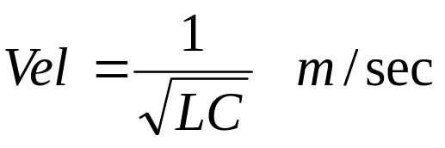
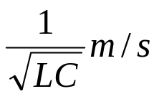
Effect 1: Propagation Delays
A simple analogy here to explain the wave is to consider the effect of suddenly opening a water valve connected to an empty coiled garden hose.
Water begins to flows at a speed governed by the pressure and the physical characteristics of the hose that resist flow e.g. diameter, twists, kinks, drag, expansion of hose as it straightens. thus the water flows more slowly than it would through “air” (where the medium is different).
The speed of any electromagnetic wave through a conductor is given by the equation.
Where ‘L’ and ‘C’ are measured in Henries and Farads per meter i.e. values that are independent of it’s length.
Conductor length ‘l’
I
V
R_{T}
Transmitter
Receiver
V
Electromagnetic wave font of amplitude ‘V’ advancing along the conductor at velocity of
Distance
Current is constant behind wave front (no back emf) and voltage is the same everywhere in the conductor behind wave front

Slide 10
The ‘LC’ characteristics of various kinds of conductor are shown in the table below along with typical signal velocity and propagation delays T_{pd}
  u₀ the permeability (inductance per meter) of free space = 1.257 x 10⁻⁶ H/m
  e₀ the permittivity (capacitance per meter) of free space = 8.854 * 10⁻¹² F/M
We can see that a high dV/dT signal propagating for 1 metre along a backplane takes 10-20ns to reach the end (depending upon the material the backplane was constructed from and how it was constructed).
By contrast, the same signal travelling through a vacuum takes just 3.3ns, i.e. that signal travels ~ 3 to 6 times faster.
Medium L ( nH/cm) C (pF/cm) Velocity(m/s) T_{pd}(ns/m)
Free Space (Vacuum) u₀ e₀ 3.1x10⁸ 3.3
Single wire (far from Ground) 20 0.06 2.5x10⁸ 4
Twisted Pair cable 5-10 0.5-1.0 2.0x10⁸ 5
Flat Cable 5-10 0.5-1.0 2.0x10⁸ 5
Track on a PCB 5-10 0.5-1.5 2.0x10⁸ 5
Coaxial Cable 2.5 1.0 2.0x10⁸ 5
Back Plane Signal 5-10 1.0-3.0 1.0 – 0.5 x10⁸ 10 - 20

Slide 11
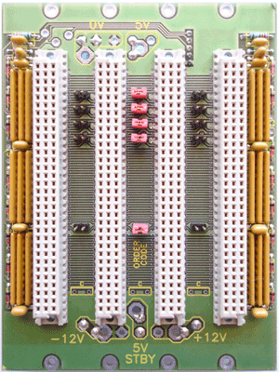
In backplanes such as VME/PCi bus, the use of plug in “modules” makes analysis more complicated by the change in L and C that occurs at the point the board is plugged
Signal propagation times thus vary depending upon the modules that are plugged in.
t_{PD} depends upon length and how many modules are plugged in
4 Slot VME bus backplane

Slide 12
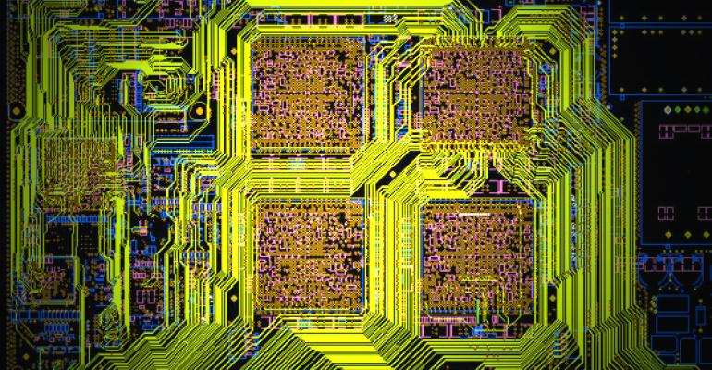
What about Normal PCB Tracks?
A typical PCB track has a signal propagation delay of ~5ns/m which is significant and comparable to the access time of a fast memory chip.
This explains why memory chips must be placed close to their controllers.
t_{PD} PCB track = 5ns/M

Slide 13
Effect 2: Reflections
A signal may also be reflected at its destination due to sudden changes in impedance.
To understand these reflections, consider what forces a current to flow in a conductor.
Voltage potential can be thought of as a ‘repulsive force’ between electrons due to their relative position/density. The force or potential is based on the electrical field generated by electrons which is stronger with higher density and electron proximity.
That is, electrons try to escape from areas of high density to areas of lower density.
So what happens in those few Pico-seconds immediately after the application of a step input signal? In particular what initial current I_{i} flows?
I_{i}
Transmission Line/Signal Conductor with L and C values
Z₀ = characteristic impedance of conductor
v
Z_{t} = terminating impedance of receiver
Signal Source
Receiver

Slide 14
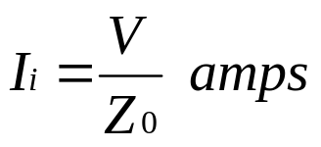
Analysing the Initial Current - I_{i}
Imagine you are the first electron ‘out of the gate’, what do you see? You cannot see ahead of yourself, thus you cannot see the terminating impedance Z_{t} at the receiver.
All you see is the initial characteristic impedance Z₀ of your conductor resisting your movement along the transmission line (like our hose analogy, the leading edge of flowing water cannot see what is at the end of the hose).
The initial current I_{i} leaving the source is independent of the terminating impedance Z_{t}
I_{i} would begin to flow even if the conductor was open circuit at the other end !!!
In fact it would flow forever if the conductor was infinitely long.
I_{i}
Transmission Line/Signal Conductor
Z₀ = characteristic impedance of conductor
v
Z_{t} = terminating impedance of receiver
Signal Source
Receiver

Slide 15
What happens during its passage through the conductor?
As the electrons leave the signal source, each has its motion resisted by the characteristic impedance Z₀ of the conductor. No electrons travel any faster or slower as they pass through each section of the line.
The electron density/voltage remains constant at all points behind the wave front and the voltage and current in the conductor behind the wave front will be consistent.
So what happens when that initial current encounters the terminating impedance Z_{t} ?
I_{i}
Transmission Line/Signal Conductor
Z₀
v
v
Distance
Z_{t} = terminating impedance of receiver (load)
Voltage font travelling along the conductor
Signal Source
Receiver

Slide 16
Case 1: Z_{t} > Z_{0,} - Large impedance at the end of line such as an Open Circuit
The electrons cannot travel as quickly and slow down/bunch up increasing the density of electrons and the voltage at Z_{t} leading to voltage overshoot.
We also see a Positive (in phase) cancelling voltage reflection back towards the signal source reducing/cancelling the initial current, all the way back to the source.
Watch: https://www.youtube.com/watch?v=ozeYaikI11g at time index 2:09
A good analogy here is to think of our electrons as line of cars travelling at the same speed along a road, spaced exactly 10 meters apart. Imagine the road ahead is closed. The 1st few cars slow down and bunch up increasing the density of cars at that point. The cars behind them cannot continue to travel at their original speed so they slow down and bunch up and this continues right back to the source. We thus observe a ‘wave’ of braking cars that appears to be travelling backwards up the highway reducing the traffic flow, as you would expect if it were a current. The electrons have no where to go and the density of electrons in the wire reaches a steady state with the voltage the same at all points and no current flows.
I_{i}
Transmission Line/Signal Conductor
Z₀
v
+Reflection
V_{over}
v
Z_{t} > Z₀
+ voltage reflection in phase with incident wave. Reflection adds to incident wave leading to voltage overshoot at Z_{t} reflection travels back so that incident wave voltage ‘V’ is seen at source cancelling out some/all the current.
Signal Source
Receiver

Slide 17
Case 2: Z_{t} < Z₀ - Small impedance at the end of line such as a Short Circuit
Electrons flow more easily in Z_{t} than Z₀ so they accelerate and spread out, reducing the density of electrons at Z_{t} and decreasing the incident voltage across the load Z_{t}
This gives rise to a negative voltage reflection (180 degrees out of phase) and a negative current flowing in the opposite direction back towards the source. Reduced voltages travel back towards the source but the current increases.
Watch: https://www.youtube.com/watch?v=ozeYaikI11g at time index 3:04
The analogy here is to think of our line of bunched up cars travelling along a single lane road, that suddenly begins to widen like a zipper unzipping at the receiver and moving backwards towards the source. The 1st few cars speed up and spread out. The cars behind them do likewise and so on. We thus observe a ‘wave’ of accelerating cars that appears to be travelling backwards increasing the flow of cars and by analogy “current” in the case of electrons.
I_{i}
Transmission Line/Signal Conductor
Z₀
v
-Reflection
v
V_{under}
Z_{t} < Z₀
- Voltage reflection (out of phase). Cancels some/all of the incident wave voltage resulting in a drop in voltage at Z_{t} leading to large currents
Signal Source
Receiver

Slide 18
Case 3: Z_{t} = Z₀ – Matched Impedance/Termination
If Z_{t} = Z₀, the electrons encounter the same impedance to their motion in Z_{t} as they have encountered all the way through the conductor and thus their electron speed and density remain the same, resulting in the same current and voltage continuing at Z_{t}
The net effect is that NO reflection takes place back towards the signal source. The load Z_{t} appears to the wave front as if it is simply the continuation of an infinitely long transmission line.
The analogy here is think of our line of cars being diverted off the highway onto a slip road with exactly the same dimensions as the highway they were travelling along and thus continue at the same speed and density.
This is important as it means that matching a receiver to the characteristic impedance of a line eliminates reflections. The problem is that digital logic gate have an almost infinite input impedance and do not match the impedance of the conductor, leading to reflections and slow signal rise times unless terminated correctly.
I_{i}
Transmission Line/Signal Conductor
Z₀
v
v
No reflection
V_{diff} = 0
Z_{t} = Z₀
Signal Source
Receiver

Slide 19
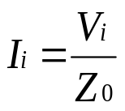


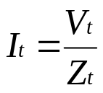
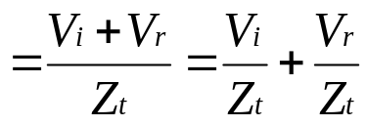
What is the Amplitude of a Reflected Wave?
The initial current I_{i} travelling down the transmission line is given by
However the current I_{t} in the terminating resistor is the current in the line
I_{i} plus the reflected current I_{r} which may be positive or negative
depending upon relative values of Z₀ and Z_{t}
The voltage V_{t} at the terminating resistor is i.e. incident + reflected
Now given these equations, we can say
V_{i}
I_{i}
Z₀
I_{t}
V_{t}
I_{r}
v
Z_{t}
V_{r}
Signal Source
Receiver

Slide 20
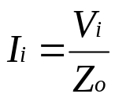
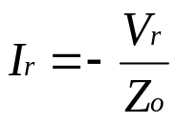
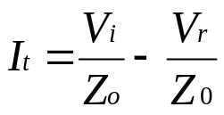
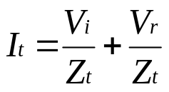
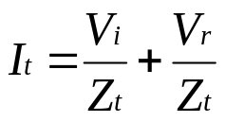
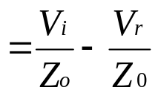
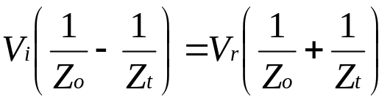
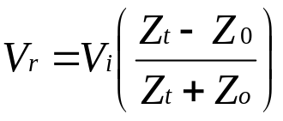
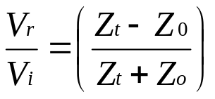
Putting it into an Equation
Similarly and The minus sign indicates a reflection back towards source
Rearranging we get and we know from previous that
Thus rearranging we get
And finally Thus the voltage reflection coefficient is
V_{i}
I_{i}
I_{t}
V_{t}
Z₀
I_{r}
v
Z_{t}
V_{r}
Signal Source
Receiver

Slide 21
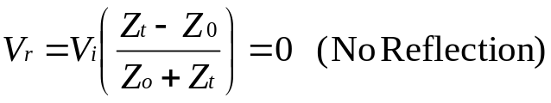
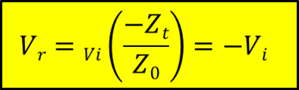
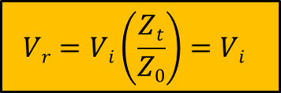
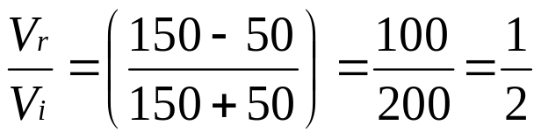
Let’s put this equation to the test
What happens if Z_{t} equals Z₀
What happens if Z_{t} = 0 (short circuit)
i.e. a negative voltage is reflected back to the source
(increasing current) and cancelling V_{i} This results in
a steady state voltage at source and end = 0 volts
What happens if Z_{t} = infinity (open circuit)
a voltage is reflected back to the source,
cancelling incoming current resulting in
a steady state voltage at source and end = V_{i}
Real Transmission Lines
What if Z₀ and Z_{t} did not match exactly? Suppose Z_{t} = 150 ohms and Z_{o} = 50 ohms
A wave of ½ the amplitude of the incident wave is reflected back towards the source. Once there, it will be reflected back towards the receiver a 2nd time after, which a reflection of half that amplitude is again reflected back towards the source etc.

Slide 22
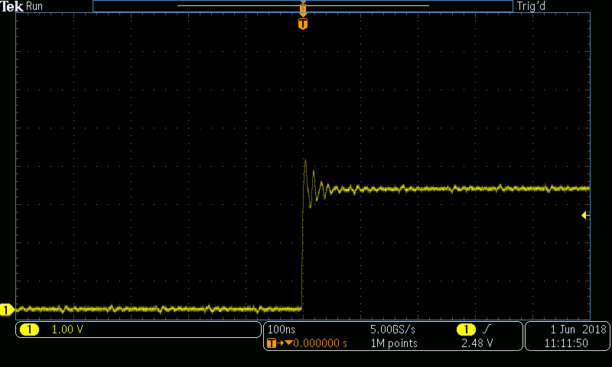
Effects of reflection seen at the end of a wire for a signal due to open circuit impedance. Source https://www.allaboutcircuits.com/technical-articles/how-to-eliminate-reflection-noise-in-your-next-pcb-design/
See also https://en.wikipedia.org/wiki/Reflected-wave_switching
Voltage Overshoot due to reflections can damage components and could be sufficient to make a signal unstable at the receiver until reflections have died down

Slide 23
Watch this real
Electrical Engineer demonstration
of termination and
reflections for square (digital) waves https://www.youtube.com/watch?v=zrDxSM91Jcg

Slide 24
What does this all mean?
It means that at high frequencies we have to take account of all the inherent track lengths on our PCB and estimate their characteristic impedances and terminate the line correctly to reduce reflections and take account of signal propagation delay.
Remember however that transmission line effects only occur when the edges of signals rise rapidly i.e. high dv/dt (generally implying high frequency signals).
Rule of Thumb (Sine Waves in a Conductor)
If the conductor is ‘short’ (e.g. a short PCB track for example) and its length is less than 1/10th the wavelength of the signal, we can simplify the transmission line model to that a ‘lumped capacitance’ model (see later slide).
Otherwise we have to treat it as a transmission line and think about matching impedances.

Slide 25
Question:
What is the maximum suggested length of two conductors carrying sine waves of
  24Mhz
  3Ghz
along a PCB track without considering it as a transmission line that requires termination?
Answer 1:
From Velocity = Frequency * Wavelength, a 24Mhz a signal has a wavelength of 2x10⁸/24x10⁶ = 8.3 meters (see page 10 for velocity of a signal along a PCB track), thus the maximum distance that such a signal should travel without you having to consider transmission line effects is 830mm.
Answer 2:
A 3Ghz signal has a wavelength in a PCB track of 0.0666m
(i.e. 2x10⁸/3x10⁹), thus the maximum distance that such a signal should travel without you having to consider transmission line effects is 6.66mm.

Slide 26
What about digital signals which are square waves?
In digital signals we are more concerned with signal edges i.e. rise and fall times which give rise to a large dV/dt, rather than sine waves and wavelength.
Rule of Thumb (Digital Signals in a Conductor)
It should be obvious that when clock speeds of digital circuits increase, rise and fall times must decrease to keep up with bit rate.
A digital signal with a rise/fall time of ‘T_{RF}’ can thus be treated as being equivalent to a sine wave with a period = 5T_{RF}
Thus a digital signal with a rise time of 0.5ns can be treated as equivalent to a sine wave with a period of 2.5ns (i.e. 400Mhz).
The longest length of PCB track you should use is thus 1/10th of 2x10⁸/4x10⁸ = 50mm.
Every track on our PCB becomes a potential transmission line and may have to be kept short or terminated to avoid reflections.

Slide 27
Terminating a Backplane/Bus
For backplanes we can limit the effect of reflections by terminating each end of the signal with a resistor roughly matching Z₀, i.e. ~ 100 ohms.
Direct termination with a single 100 ohm resistor down to ground places a large electrical load on the signal (meaning large current) and also means that the circuit driving the signal struggles to switch the signal voltage between 0 and 1 (due to charge and discharge of capacitance of track)
VME bus therefore terminates the signal with a pair of resistors whose combined Thevenin (parallel) equivalent is approximately equivalent to Z₀
In the circuit opposite, the combined impedance of the two resistors is 194 ohms (330R in parallel with 470R via the PSU).
The signal termination voltage produced by these resistors is 2.9v (just above the logic 1 threshold voltage) which allows faster switching between 0 and 1 as signals can reach their desired logic levels without waiting for reflections.
VME Bus Signal Termination
VCC
Terminating Voltage V_{t} = 2.94v
Bus Signal
330R
Transmitter
470R
Receiver
GND
See article on termination techniques for high speed buses on Connect
http://www.interfacebus.com/Design_Termination.html

Slide 28
t_{PD} = 20ns/M
Terminating resistors for each signal at each end of a VME bus backplane (transmission line) to reduce reflections.

Slide 29
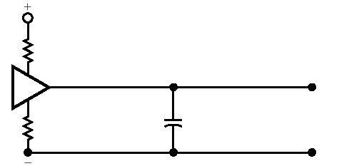
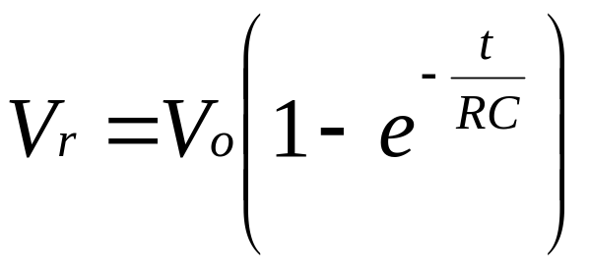
The Lumped RC Model
Simplified model if a conductor is ‘short’ and/or rise-fall time of a digital signal is slow.
Considers all distributed capacitances to be a single capacitor in the middle.
‘C’ = combined capacitance of all loads.
‘R’ The output resistance of the signal driver.
This simplification allows us to assume that the signal will rise at the receiver end according to the equation opposite.
Given the input voltage threshold of the device, we can figure out how long it takes for the signal to rise from logic 0 to logic 1.
For example, a 5v driver with R = 50 ohm driving 10 logic gates in parallel, each with C = 5pf
  @ 1.0 nS, V_{out} = 1.65v (33% of max)
  @ 2.5 nS, V_{out} = 3.15v (63% of max)
  @ 5.0 nS, V_{out} = 4.30v (86% of max)
  @ 7.5 nS, V_{out} = 4.75v (95% of max)
Simplification based on low frequency and/or short conductor length
Signal Driver
Receiver
R
V_{out}
V_{in}
C
V_{out}
V_{in}
See: https://www.allaboutcircuits.com/textbook/direct-current/chpt-16/voltage-current-calculations/
In other words, to raise the voltage at the receiver V_{out} from 0 to 2.4 volts (the input threshold for logic 1 in TTL) would take 1.6ns. This is the propagation delay of the signal.

Slide 30
Sample Example Problems
(Tutorial Style)

Slide 31
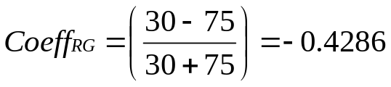
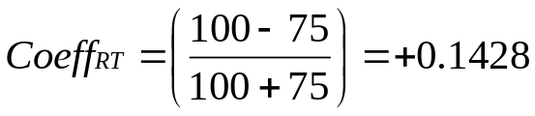
Sample Problem 1
A signal generator with an internal resistance R_{G} = 30 ohms is connected to a transmission line with a characteristic impedance Z₀ = 75 ohms.
The line is terminated with a load resistance R_{T} = 100 ohms.
Determine the reflection coefficients at the load resistance R_{T} and the generator resistance R_{G} when a wave emerges from either end of the transmission line.
Note
+ve reflection coefficient means we add the amplitude of incident and reflected waves.
-ve reflection coefficients means we subtract the amplitude of the incident and reflected waves.
R_{G} = 30 ohms
Z₀ = 75 ohms
Wave front direction for
(1st , 3rd etc reflection)
Signal
Direction for change of impedance
(2nd , 4th etc reflection)
v
R_{T} = 100 ohms
Signal Source
Receiver

Slide 32
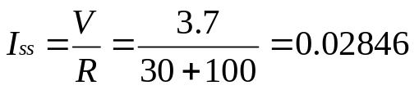
Sample Problem 2
If the voltage of the signal generator is 3.7 volts, what is the steady state voltage at the intersection of R_{T} and R_{G} after all reflections have died down, i.e. simple ohms law stuff.
In the steady state, when all reflections have died down, the impedance Z₀ of the transmission line is ~0 ohms since the rate of change of voltage dv/dt is 0 and thus the capacitive and inductive effects of the line have ceased.
This is now a simple potential divider problem.
R_{G} = 30 ohms
Z₀ = 75 ohms
3.7v
v
R_{T} = 100 ohms
Signal Source
Receiver

Slide 33
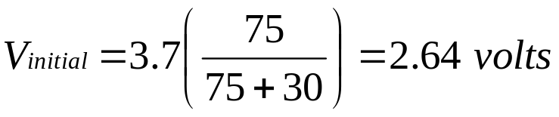
Sample Problem 3
Calculate the voltage reflections at each end for several reflections when an initial step voltage of 3.7 volts is generated by the signal source.
Step 1 – Calculate Voltage at start of Conductor
The initial voltage applied to the line is 2.64 volts since the internal resistance of the generator R_{G} (30 ohms) forms a potential divider with the conductors characteristic impedance Z₀ (75 ohms).
At least that is how the 1st electrons leaving the signal source see it, as they cannot see the terminating resistance R_{T} of the receiver because they have not yet reached it.
In the steady state when currents have stabilised and the transmission line offers no impedance, the voltage Vt = 3.7 * (100)/(130) or 2.846v
R_{G} = 30 ohms
2.64v
Z₀ = 75 ohms
3.7v
v
R_{T} = 100 ohms
Signal Source
Receiver

Slide 34
Step 2
Plot a lattice diagram showing the reflections and thus the voltages at each end of the transmission line (i.e. at generator and load) with each reflection. Hint: Calculate all reflection voltages first, then the voltage at the end of the line based on +/- reflection coefficient. V_{Load} = (V_{Incident} + V_{Reflection})
Generator: Reflection coefficient = - 0.4285, subtract incident and reflected wave
t=0
2.6428v
Receiver: Reflection coefficient = +0.1428, add incident and reflected wave
V_{i} = 2.6428v
V_{r1} = (2.6428 x 0.1428) = 0.3774v
V_{i} = 3.02v
t=T
V_{load} = (incident + reflection)
= 3.02v (overshoot)
V_{Gen} = (3.02 – 0.1616)
= 2.8584v
t=2T
V_{r2} = (0.3774 x -0.4285) = -0.1616v
V_{i} = 2.8584v
V_{r3} = (-0.162 x 0.1428) = -0.0231v
V_{i} = 2.8353v
t=3T
V_{load} = (2.8584 - 0.0231)
= 2.8353v
V_{Gen} = (2.8353 + 0.0099)
= 2.8452v
t=4T
V_{r4} = (-0.0231 x -0.4285) = 0.0099v
V_{i} = 2.8452v
V_{r5} = (0.0099 x 0.1428) = 0.0014v
V_{i} = 2.8466v
t=5T
V_{load} = (2.8452 + 0.0014)
= 2.8466v
V_{Gen} = (2.8466 – 0.0006)
= 2.846v
t=6T
V_{r6} = (0.0014 x -0.4285) = -0.0006v
V_{i} = 2.846v
V_{Gen} and V_{load} converging on same voltage: 2.846 which is correct for steady state
t=7T
V_{load} = (2.846 - 0.000085)
= 2.8465v

